Slide 1
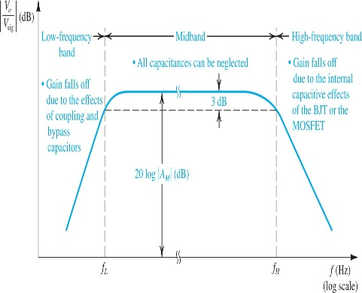
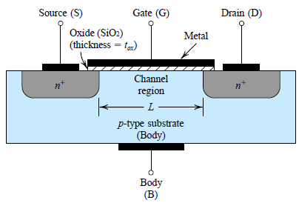
9.2. Internal Capacitive Effects and the High-Frequency Model of the MOSFET and BJT
While coupling & bypass capacitors cause the gain of transistor amplifiers to fall off at the low frequency end, the gain falloff at high frequencies is caused by the capacitive effects internal to the transistors.
MOSFET has internal capacitance (this is apparent).
The gate capacitive effect: The gate electrode forms a parallel plate capacitor with the channel.
The source-body and drain-body depletion layer capacitances: These are the capacitances of the reverse-biased pn-junctions.
Previously, it was assumed that charges are acquired instantaneously - resulting in steady-state model.
This assumption poses problem for frequency analysis.
Physical structure of NMOS transistor

Slide 2
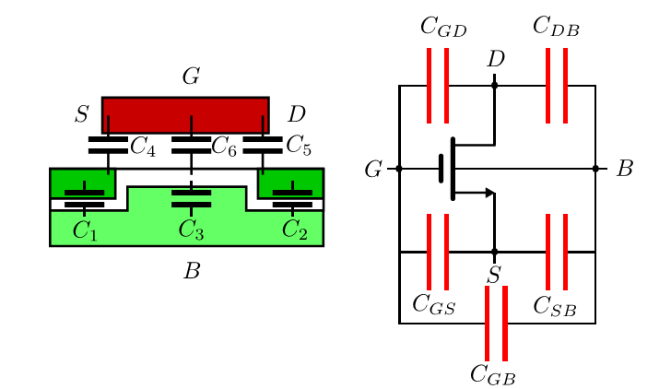
The Gate Capacitive Effect
The gate capacitive effect can be modeled by the three capacitances C_{gs}, C_{gd}, and C_{gb}. The values of these capacitances can be determined as follows:
C_{ox}: oxide capacitance
C₄ and C₅ are C_{ov}

Slide 3
The Junction Capacitances
The depletion-layer capacitances of the two reverse-biased pn junctions formed between each of the source and the drain diffusions and the body
where C_{sb0} is the value of C_{sb} at zero body-source bias, V_{SB} is the magnitude of the reverse bias voltage, and V₀ is the junction built-in voltage (0.6 V to 0.8 V).
where C_{db0} is the capacitance value at zero reverse-bias voltage, and V_{DB} is the magnitude of
this reverse-bias voltage.

Slide 4
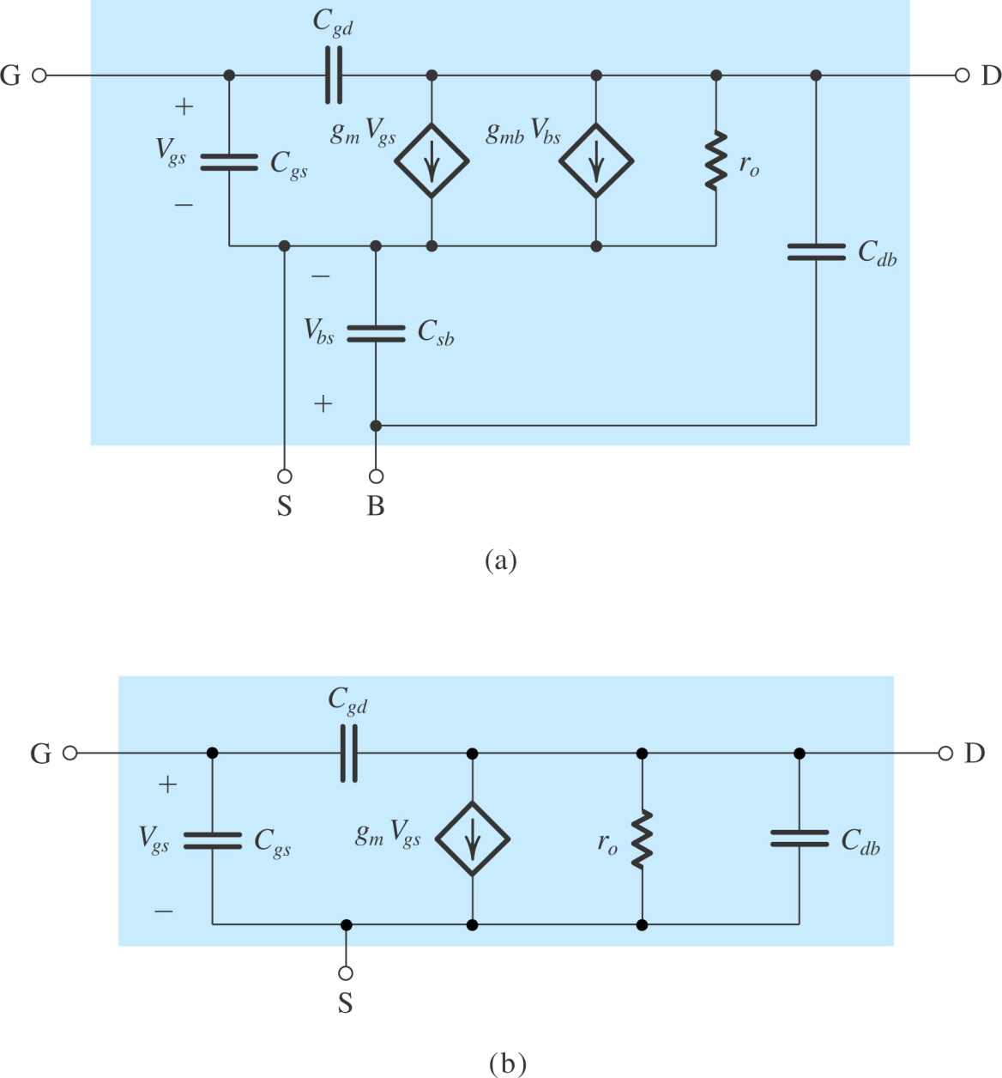
The High-Frequency MOSFET Model Fig. 9.6(a) shows the small-signal model of the MOSFET, including the four capacitances C_{gs}, C_{gd}, C_{sb}, and C_{db}. This model can be used to predict the high-frequency response of MOSFET amplifiers. But quite complex
for manual analysis.
In Fig. 9.6(b) - the source is connected to the body. In this model, C_{gd}, although small, plays a significant role in determining the high-frequency response of amplifiers and thus must be kept in the model.
Figure 9.6 (a) High-frequency, equivalent-circuit model for the MOSFET. (b) The equivalent circuit for the case in which the source is connected to the substrate (body). (continued)

Slide 5
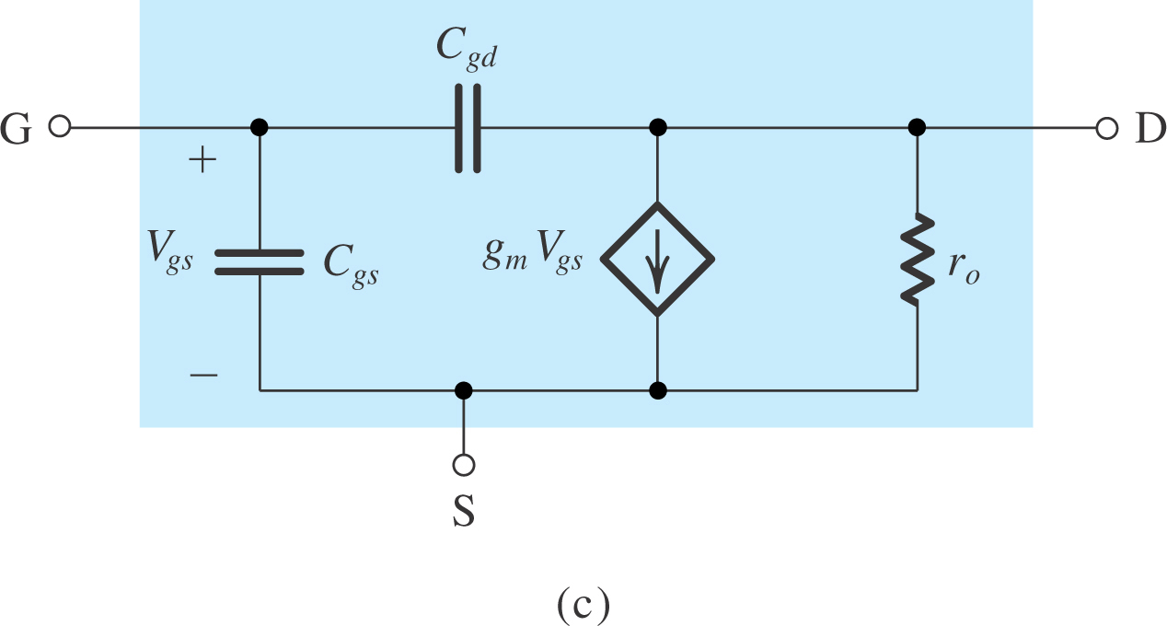
Figure 9.6: (continued) (c) The equivalent-circuit model of (b) with C_{db} neglected (to simplify analysis).

Slide 6
The MOSFET Unity-Gain Frequency (f_{T})
A figure of merit for the high-frequency operation of the MOSFET as an amplifier is the unity-gain frequency, f_{T}, also known as the transition frequency. This is defined as the frequency at which the short-circuit current-gain of the common-source configuration becomes unity.
Figure shows the MOSFET hybrid-π model with the source as the common terminal between the input and output ports.
To determine the short-circuit current gain, the input is fed with a current-source signal I_{i} and the output terminals are short-circuited. It can be seen that the current in the short circuit is given by
I_{o} = g_{m}V_{gs} – sC_{gd}V_{gs}

Slide 7
The MOSFET Unity-Gain Frequency (f_{T})
C_{gd} is small, at the frequencies of interest the second term in this equation can be neglected,
(f_{T} = ω_{T} / 2π)
Note: for physical frequencies s = jω, it can be seen that the magnitude of the current gain becomes unity at the frequency ω_{T} = g_{m} ⁄ (C_{gs} + C_{gd})

Slide 8
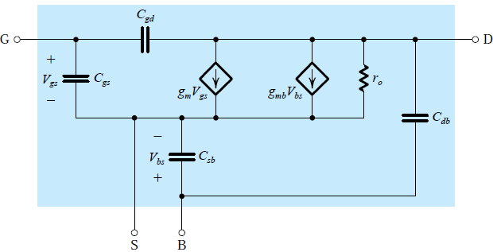
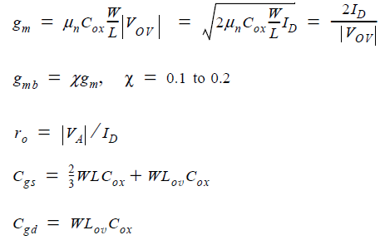
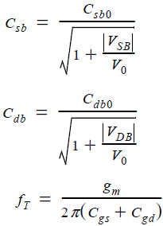
Table 9.1 The MOSFET High-Frequency Model
Model
Model Parameters

Slide 9
9.2.2. The BJT
Like MOSFET, previously it was assumed that transistor action was instantaneous.
steady-state model
neglects frequency-dependence
Actual transistors exhibit charge-storage.
An augmented BJT model is required to examine this dependence.
The resulting augmented BJT model will be able to predict the observed dependence of amplifier gain on frequency, and the time delays that transistor switches and logic gates exhibit.

Slide 10
9.2.2. The BJT
The Base-Charging or Diffusion Capacitance C_{de} When the transistor is operating in the active mode, minority carrier charge is stored in the base region. For an npn transistor, the stored electron charge in the base, Q_{n}
Which is the average time a charge carrier (electron) spends in crossing the base (10ps to 100ps)
Value of C_{je} at zero voltage
Value of C_{µ} at zero voltage
m
Grading coefficient of CBJ (0.3 to 0.5)
(The Collector-Base Junction capacitance)
CBJ Built in voltage (0.75V)
Notes:
τ_{F} is average time a charge carrier (electron) spends in crossing the base.

Slide 11
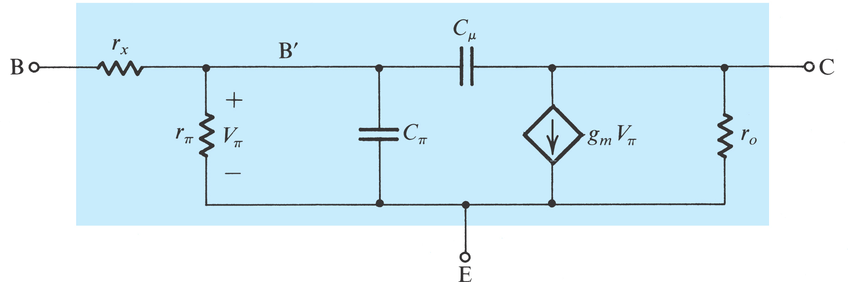
9.2.2. The BJT
The High-Frequency Hybrid-π Model as seen in figure 9.8: there are two capacitances: the emitter–base capacitance C_{π} = C_{de} + C_{je} and the collector–base capacitance C_{μ} . Typically, C_{π} is in the range of a few picofarads to a few tens of picofarads, and C_{μ} is in the range of a fraction of a picofarad to a few picofarads.
Model resistance of silicon material of the base region
(Few tens of Ωs) Since r_{x} <<< r_{π} , its effect is negligible at low frequencies , it becomes apparent in the high frequencies
Figure 9.8 The high-frequency hybrid-π model.

Slide 12
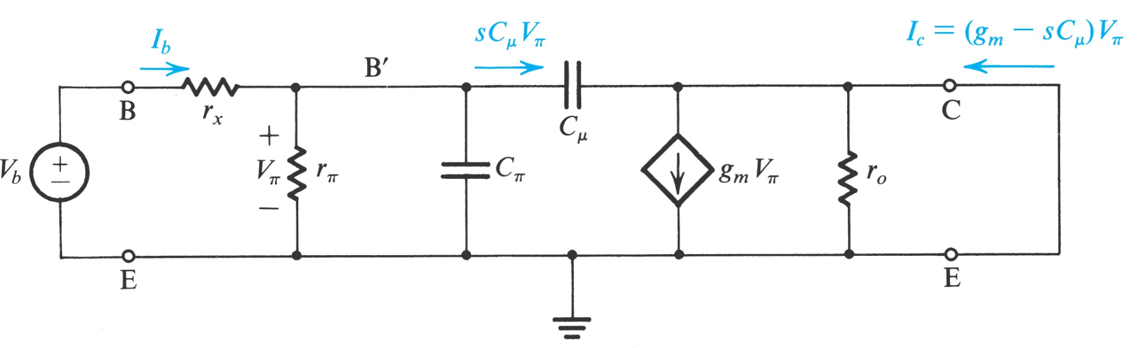
The Cutoff Frequency
The behavior of β (or h_{fe}) versus frequency is normally given. To determine C_{π} and C_{μ} , we shall derive an expression for h_{fe}, the CE short-circuit current gain, as a function of frequency in terms of the hybrid-π components. For this purpose consider the circuit shown in Fig. 9.9, in which the collector is shorted to the emitter.
Figure 9.9 Circuit for deriving an expression for h_{fe}(s) ≡ I_{c} ⁄ I_{b}

Slide 13





The Cutoff Frequency
A node equation at C provides the short-circuit collector current I_{c} as
Current gain
β_{o}
ω_{T}
ω
ω_{β}
ωC_{μ} << g_{m}
where β₀ is the low-frequency value of β. Thus h_{fe} has a single-pole (or STC) response with a 3-dB frequency at ω = ω_{β} , where

Slide 14
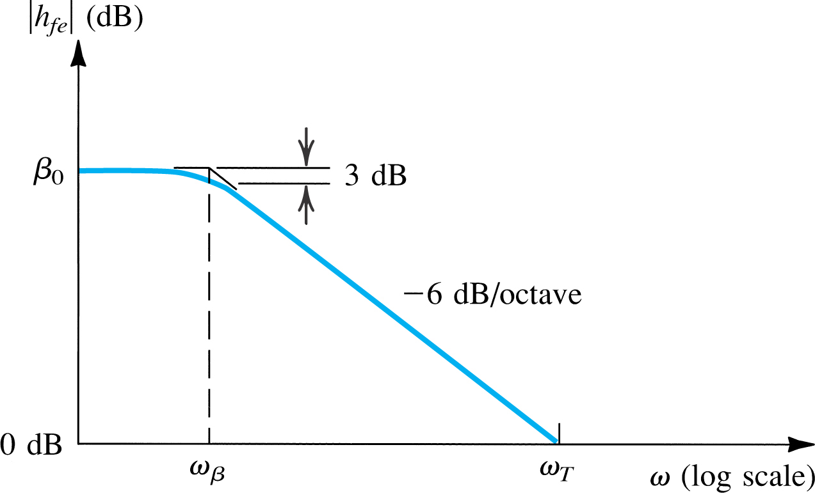


Figure 9.10 shows a Bode plot for |h_{fe}|. From the –6-dB/octave slope, it follows that the frequency at which drops to unity, which is called the unity-gain bandwidth ω_{T},
Figure 9.10 Bode plot for |h_{fe}|
The unity-gain bandwidth f_{T} , also known as the transition frequency, is usually specified on the data sheets of a transistor.

Slide 15
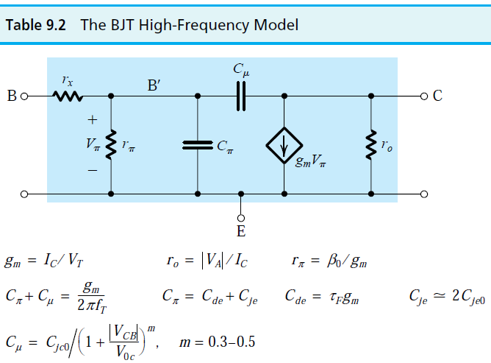
Note: the hybrid-π model of Fig. 9.8 characterizes transistor operation fairly accurately up to a frequency of about 0.2 f_{T} .

Slide 16
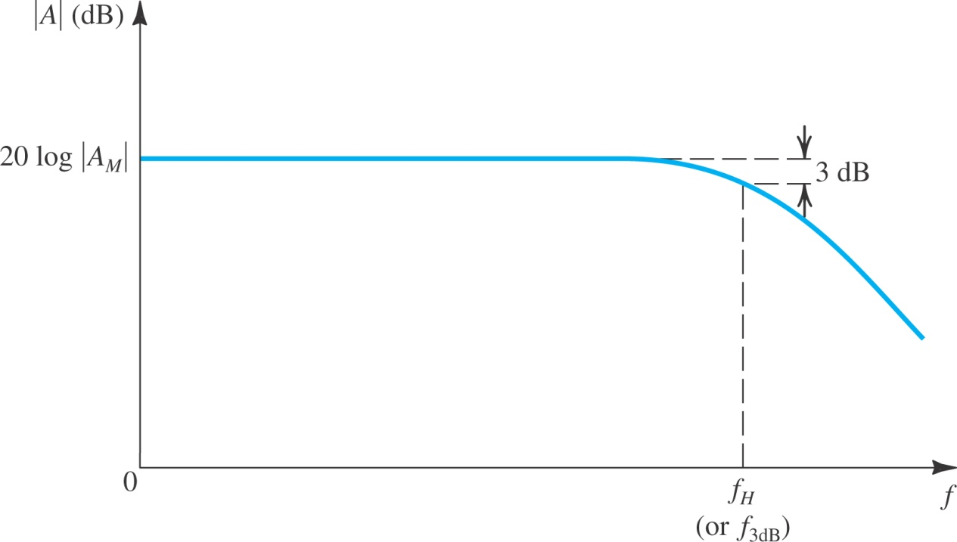
9.3. High-Frequency Response of the CS and CE Amplifiers
Objective is to identify the mechanism that limits high-frequency performance of these important amplifier configurations. As well, we need to find a simple approach to estimate the frequency f_{H} at which the gain falls by 3 dB below its value at midband frequencies, |A_{M}|.
Figure 9.12: Frequency response of a direct-coupled (dc) amplifier. Observe that the gain does not fall off at low frequencies, and the midband gain A_{M} extends down to zero frequency.

Slide 17
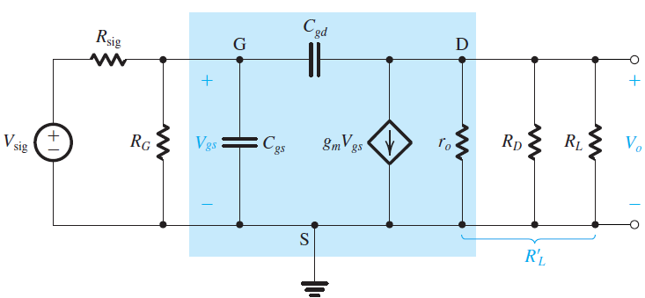
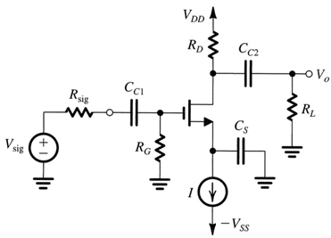
9.3.1. The Common-Source Amplifier
Figure 9.13(a) shows high-frequency equivalent-circuit model of a CS amplifier.
MOSFET is replaced with model of Figure 9.6(c).
It may be simplified using Thevenin’s theorem at the input side and by combining the three parallel resistances at the output side. The resulting simplified circuit is shown in Fig. 9.13(b).
Also, bridging capacitor (C_{gd}) may be redefined.
C_{gd} gives rise to much larger capacitance C_{eq}.
The multiplication effect that it undergoes is known as the Miller Effect.
Figure 9.13 (a)

Slide 18

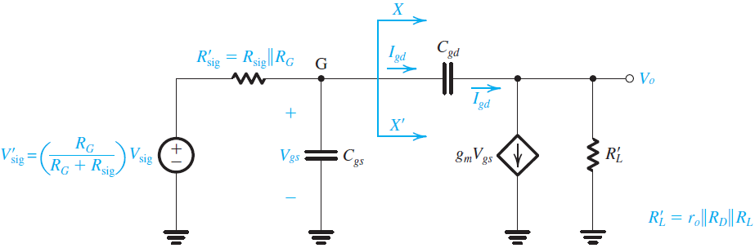
9.3.1. The Common-Source Amplifier
Midband gain A_{M} can be found from this
circuit by setting C_{gs} & C_{gd} to zero. The result is:
Figure 9.13 (b)
Figure 9.13: Determining the high-frequency response of the CS amplifier: (a) equivalent circuit; (b) the circuit of (a) simplified at the input and the output; (Continued)

Slide 19
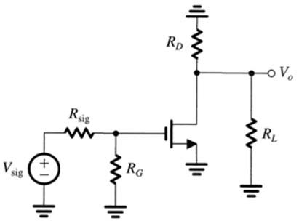
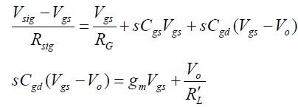
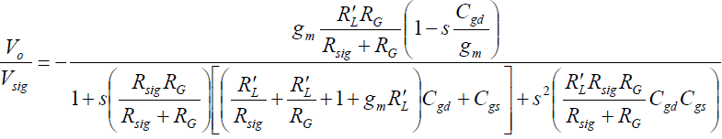
9.3.1. The Common-Source Amplifier
Frequency response:
The common-source amplifier has one zero and two poles at higher frequencies
The amplifier gain falls off at frequencies beyond midband
The amplifier bandwidth is defined by the 3-dB frequency which is typically evaluated by the dominant pole (the lowest-frequency pole) in the transfer function

Slide 20



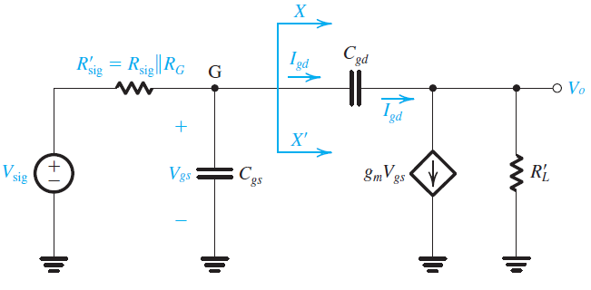
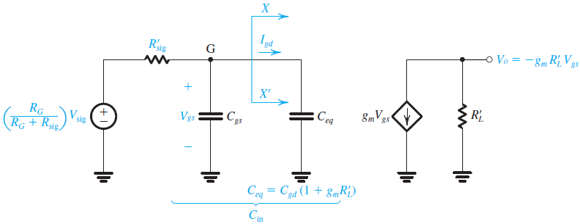

9.3.1. The Common-Source Amplifier
Simplified analysis technique
Assuming the gain is nearly constant (≅ -g_{m}R’_{L})
Find the equivalent capacitance of C_{gd} at the input (with identical I_{gd})
Replaced by C_{eq}
➔ Miller effect
Figure 9.13 (b)

Slide 21
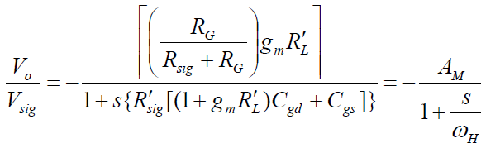


9.3.1. The Common-Source Amplifier
Neglect the small current I_{gd} at the output
Figure 9.13 (c)
ω_{H} is the upper 3-dB frequency
Thus: the high-frequency response will be that of a low-pass STC network with a
3-dB frequency f_{H} determined by the time constant C_{in}R′_{sig}

Slide 22
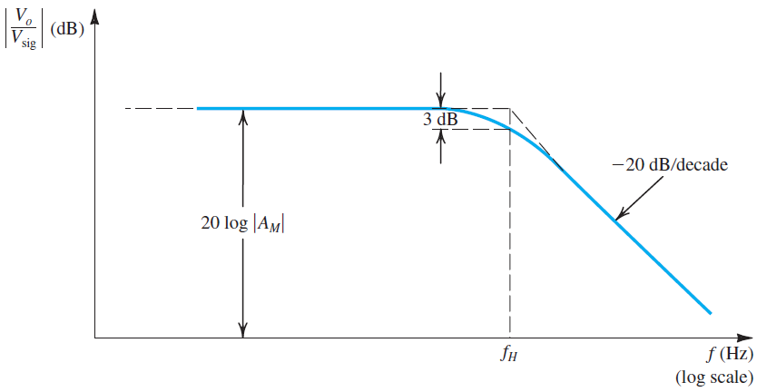
9.3.1. The Common-Source Amplifier
Figure 9.13(d) shows a sketch of the magnitude of the high-frequency gain.
Figure 9.13 (d)
Figure 9.13: (d) the frequency response plot, which is that of a low-pass, single-time-constant circuit.

Slide 23
Example 9.3

Slide 24
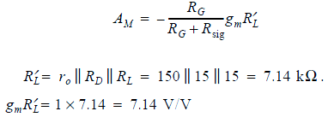

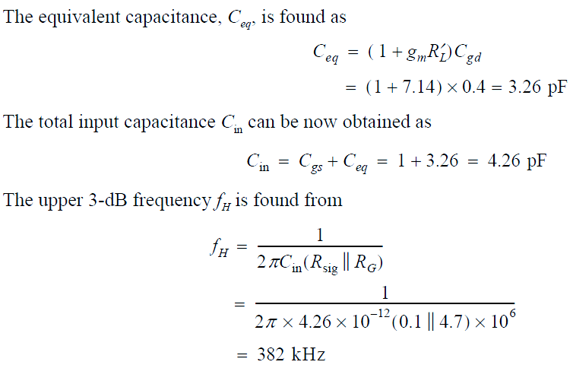
Solution
where
Thus

Slide 25
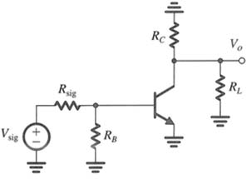
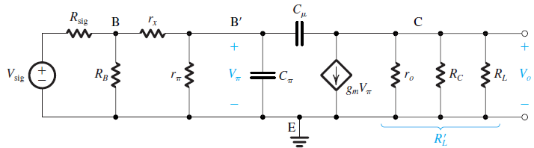
9.3.2. The Common-Emitter Amplifier
Figure 9.14(a) shows high-frequency equivalent circuit of a CE amplifier.
BJT is replaced.
This figure applies to both discrete and IC amps.
This figure may be simplified using Thevenin’s theorem at the input side and by combining the three parallel resistances at the output side.
C_{in} is simply sum of C_{π} and Miller capacitance C_{μ}(1+g_{m}R_{L}’)
Figure 9.14 (a)
Figure 9.14: Determining the high-frequency response of the CE amplifier: (a) equivalent circuit;

Slide 26
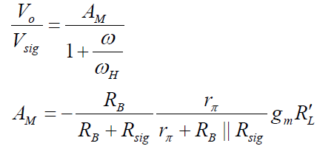
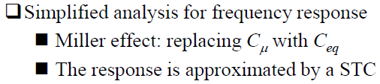
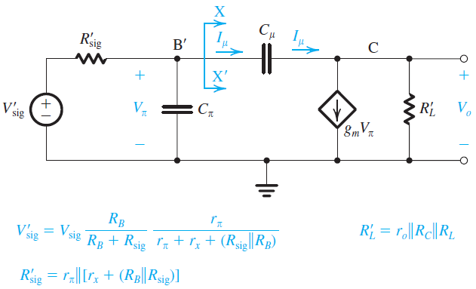


9.3.2. The Common-Emitter Amplifier
The 3-dB frequency f_{H} is given by
Where:
Figure 9.14 (b)
Figure 9.14: (b) the circuit of (a) simplified at both the input side and the output side; (continued)

Slide 27
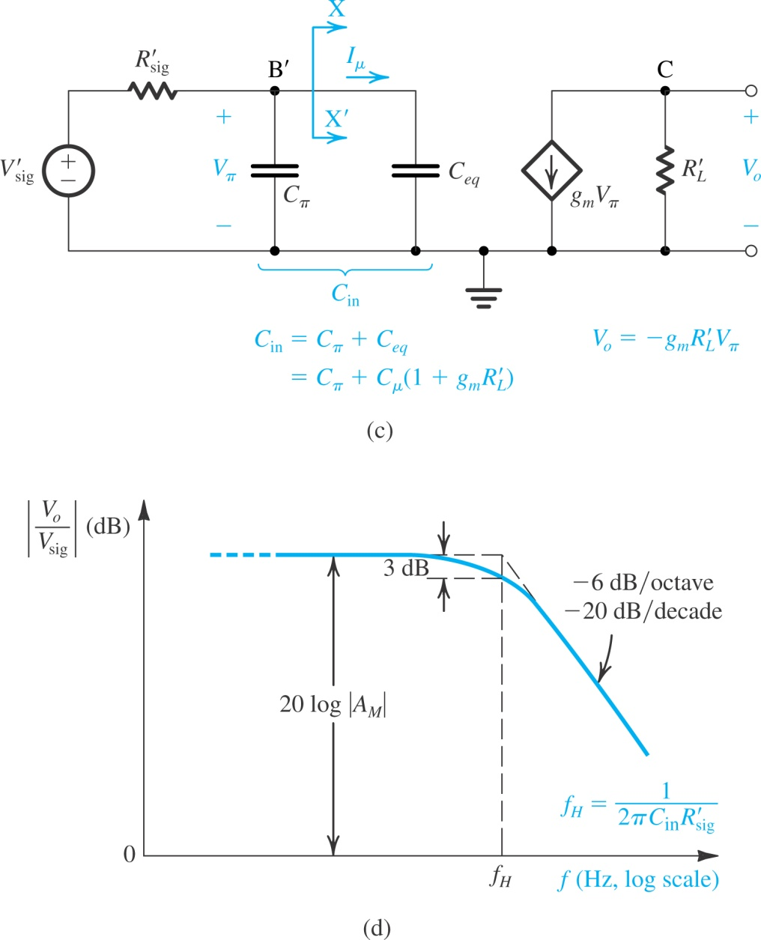
Figure 9.14 (c) equivalent circuit with C_{μ} replaced at
the input side with the equivalent capacitance C_{eq};
Figure 9.14 (d) sketch of the frequency-response plot, which is that of a low-pass STC circuit.

Slide 28
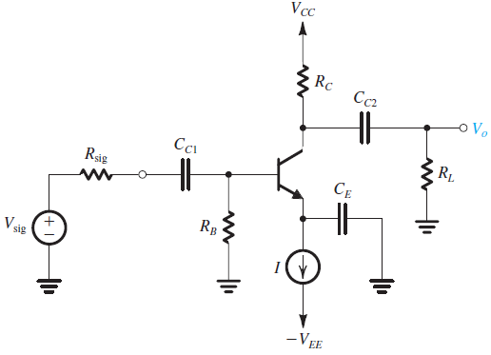
Example 9.4
It is required to find the midband gain and the upper 3-dB frequency of the common-emitter amplifier of Fig. 9.4(a) for the following case: V_{CC} = V_{EE} = 10 V, I = 1 mA, R_{B} = 100 kΩ, R_{C} = 8 kΩ, R_{sig} = 5 kΩ, R_{L} = 5 kΩ, β₀ = 100, V_{A} = 100 V, C_{μ} = 1 pF, f_{T} = 800 MHz, and r_{x} = 50 Ω.

Slide 29
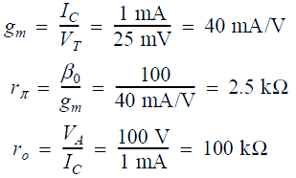
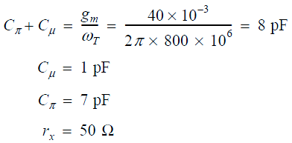


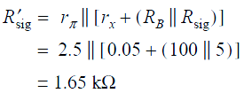

Solution
The transistor is biased at I_{C} ≈ 1 mA. Thus the values of its hybrid-π model parameters are
The midband voltage gain is
Where R_{L}′ = r_{o} || R_{C} || R_{L} = (100 || 8 || 5) kΩ = 3 kΩ
→ g_{m}R_{L}′ = 40 × 3 = 120 V/V
20log|A_{M}| = 32 dB
To determine f_{H} we first find C_{in}, C_{in} = C_{π} + C_{μ}(1 + g_{m}R_{L}′) = 7 + 1(1 + 120) = 128 pF
and the effective source resistance R’_{sig}

Slide 30
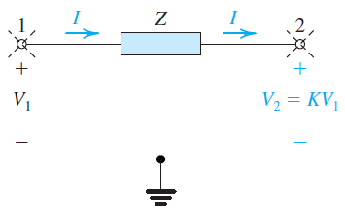
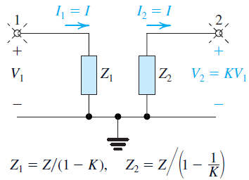
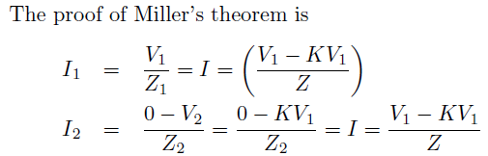
9.4.4. Miller’s Theorem
Consider the situation shown in Figure 9.17(a).
It is part of a larger circuit which is unknown.
Miller’s Theorem states that impedance Z can be replaced with two impedances:
Z1 connected between node 1 and ground
(9.76a) Z₁ = Z/(1-K)
Z2 connected between node 2 nd ground where
(9.76b) Z₂ = Z/(1-1/K)
Figure 9.17(a)
Figure 9.17(b)

Slide 31
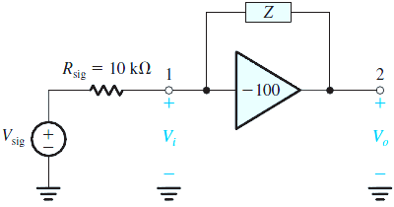
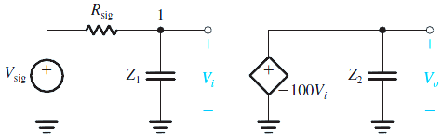
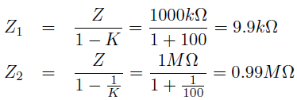

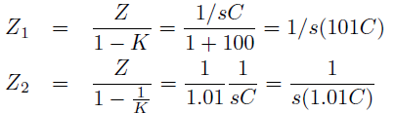

Example 9.7
An ideal voltage amp. having a gain of -100 V/V with an impedance Z connected bw. its output and input terminals. Find the Miller equivalent circuit when Z is (a) a 1-MΩ resistance, and (b) a 1-pF capacitance. In each case, use the equivalent circuit to determine V_{o}/V_{sig}.
Figure 9.18 Circuits for Example 9.7
Solution
(a) For Z = 1 MΩ, employing Miller’s theorem results in the equivalent circuit in Fig. 9.18(b), where
The voltage gain can be
(b) For Z as a 1-pF capacitance

Slide 32
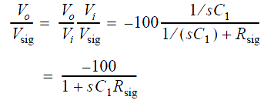
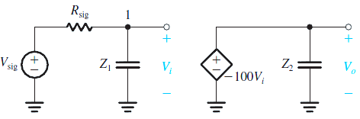



Solution
It follows that Z₁ is a capacitance 101C = 101 pF and that Z₂ is a capacitance 1.01C = 1.01 pF. The resulting equivalent circuit is shown in Figure below, from which the voltage gain can be found as follows:
This is the transfer function of a first-order low-pass network with a dc gain of −100 and a 3-dB frequency f_{3dB} of
The multiplication of a feedback capacitance by (1−K) is referred to as Miller multiplication or Miller effect.

Slide 33
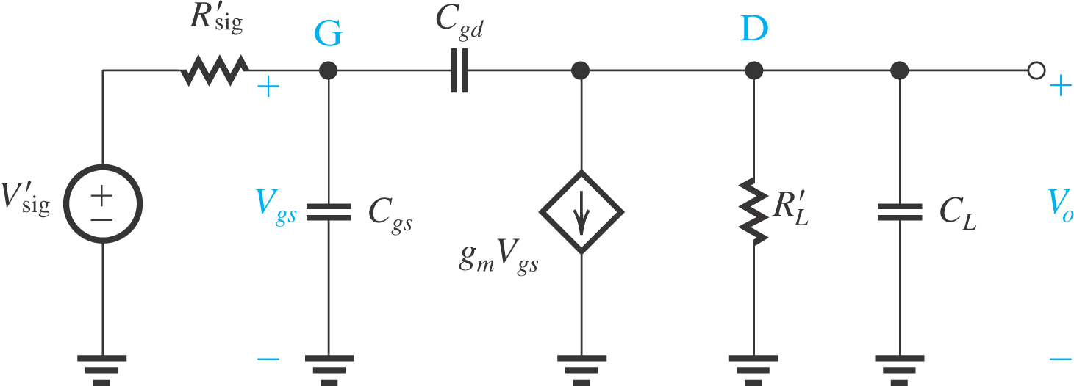
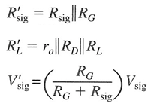
9.5 A Closer Look at the High-Frequency
Response of the CS and CE Amplifiers
9.5.1 The equivalent circuit of a CS amplifier
Figure 9.19 Generalized high-frequency equivalent circuit for the CS amplifier
• V ′_{sig} & R′_{sig} are the Thevenin equivalent of the signal generator.
• R′_{L} represents the total resistance bw. output (drain) node and ground and includes
R_{D}, r_{o}, & R_{L}.

Slide 34
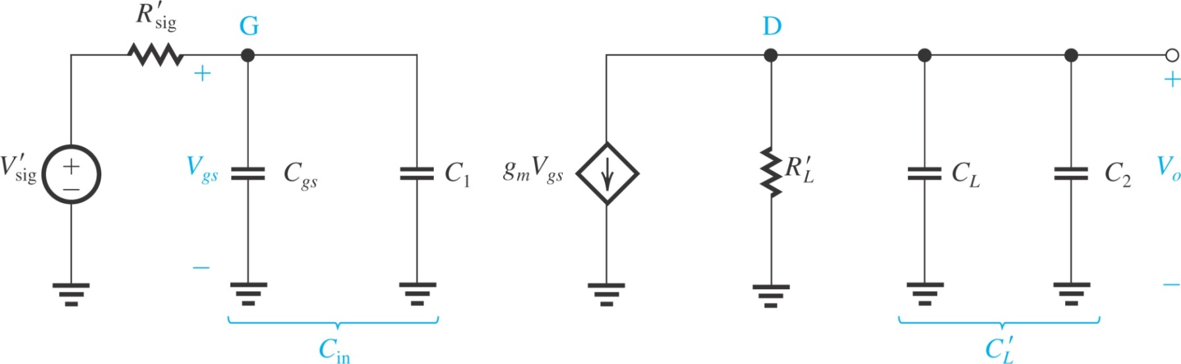


9.5.2. Analysis Using Miller’s Theorem
Figure 9.20: The high-frequency equivalent circuit model of the CS amplifier after the application of Miller’s theorem to replace the bridging capacitor C_{gd} by two capacitors: C₁ = C_{gd}(1-K) and C₂ = C_{gd}(1-1/K), where K = V₀/V_{gs}.
Since V_{o} ≈ −g_{m}V_{gs}R′_{L}, That is, K is given by K ≈ g_{m}R′_{L}
At the input side, the input capacitance C_{in} = C_{gs} +C₁ together with R′_{sig} forms an STC low-pass circuit with a pole freq. f_{Pi}:

Slide 35

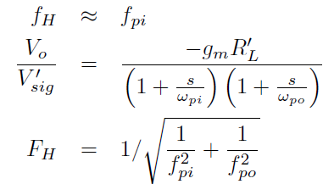
9.5.2. Analysis Using Miller’s Theorem
At the output sides C′_{L} = C_{L} + C₂ together with R′_{L} forms an STC low-pass circuit with a pole freq. f_{Po},
Read the example 9.8 in the text book (page 734)

Slide 36
Summary
The coupling and bypass capacitors utilized in discrete-circuit amplifiers cause the amplifier gain to fall off at low frequencies. The frequencies of the low-frequency poles can be estimated by considering each of these capacitors separately and determining the resistance seen by the capacitor. The highest-frequency pole is that which determines the lower 3-dB frequency (f_{L}).
Both MOSFET and the BJT have internal capacitive effects that can be modeled by augmenting the device hybrid-pi model with capacitances.
MOSFET: f_{T} = g_{m}/2π(C_{gs}+C_{gd})
BJT: f_{T} = g_{m}/2π(C_{π}+C_{μ})

Slide 37
Summary
The internal capacitances of the MOSFET and the BJT cause the amplifier gain to fall off at high frequencies. An estimate of the amplifier bandwidth is provided by the frequency f_{H} at which the gain drops 3dB below its value at midband (A_{M}). A figure-of-merit for the amplifier is the gain-bandwidth product (GB = A_{M}f_{H}). Usually, it is possible to trade gain for increased bandwidth, with GB remaining nearly constant. For amplifiers with a dominant pole with frequency f_{H}, the gain falls off at a uniform 6dB/octave rate, reaching 0dB at f_{T} = GB.
The high-frequency response of the CS and CE amplifiers is limited by the Miller effect.

